Slide 1
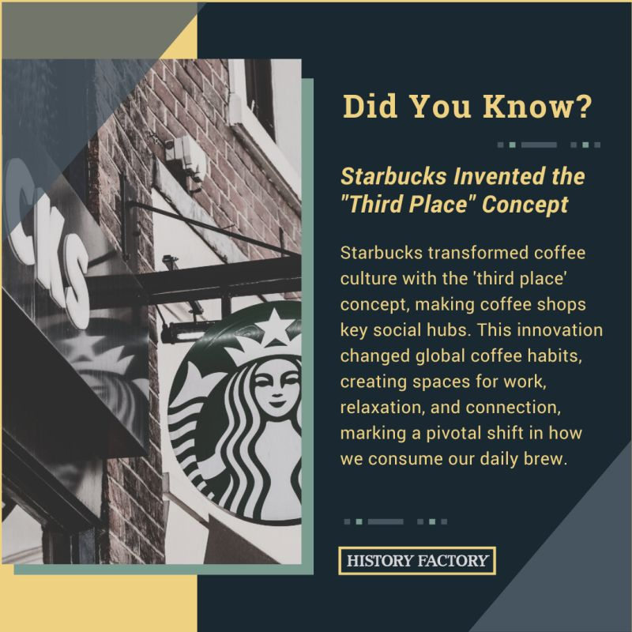
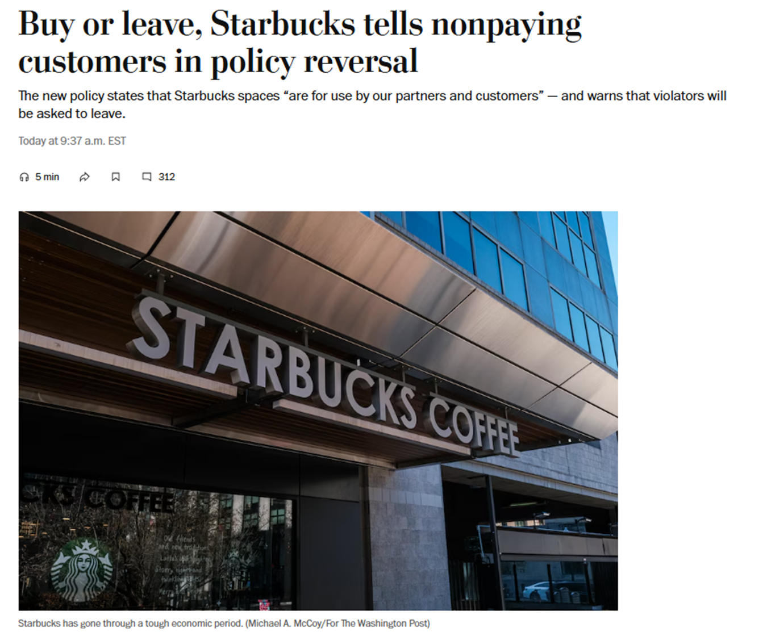
Starbucks Policies

Slide 2
CHAPTER 2
The Gaps Model of Service Quality

Slide 3
Chapter Overview
Introduce the GAPS Model of Service Quality.
Demonstrate that the gaps model is a useful framework for understanding service quality in an organization.
Explain why the most critical service quality gap to close is the customer gap.
Show that four gaps that occur in companies are collectively responsible for the customer gap.
Identify the factors responsible for each of the four provider gaps.

Slide 4
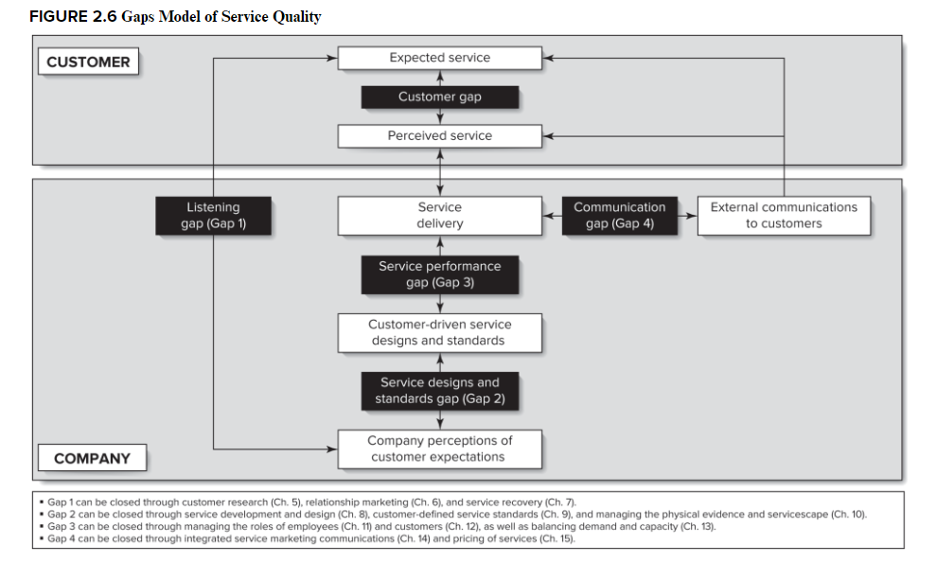

Slide 5
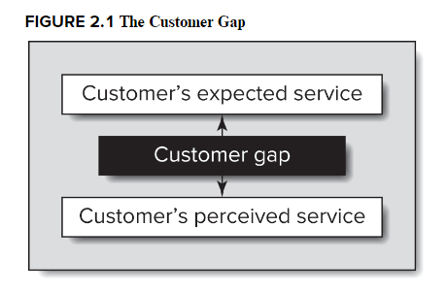
The Gaps Model of Service Quality
    This model systematically organizes the key concepts, strategies, and decisions in service marketing.
    The customer gap is the difference between customer expectations and perceptions.
    About 49% of customers say they left a brand due to poor customer service, and those businesses might not even suspect that's the reason (Forbes, 2023).
Notes:
Customer expectations are standards or reference points that customers bring into service experience. Customer perceptions are subjective assessments of their actual service experiences. Customer expectations – what customer believes should or will happen.

Slide 6
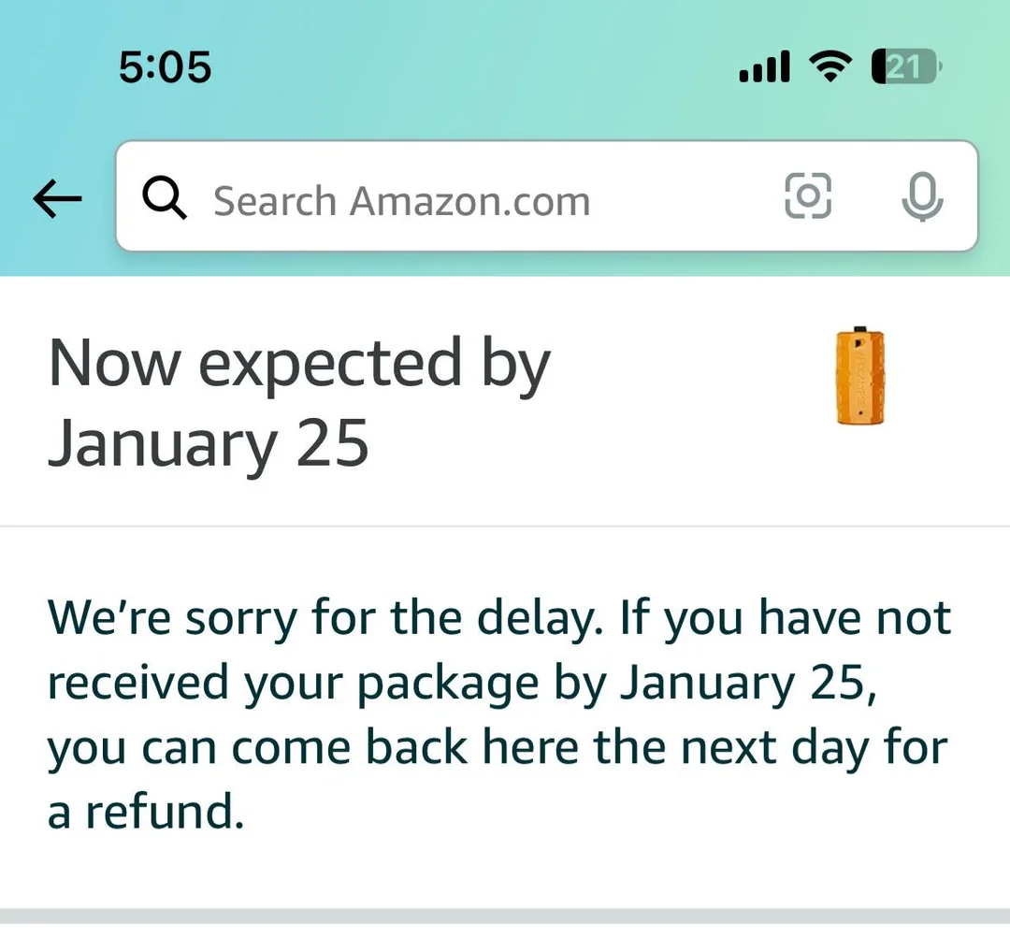
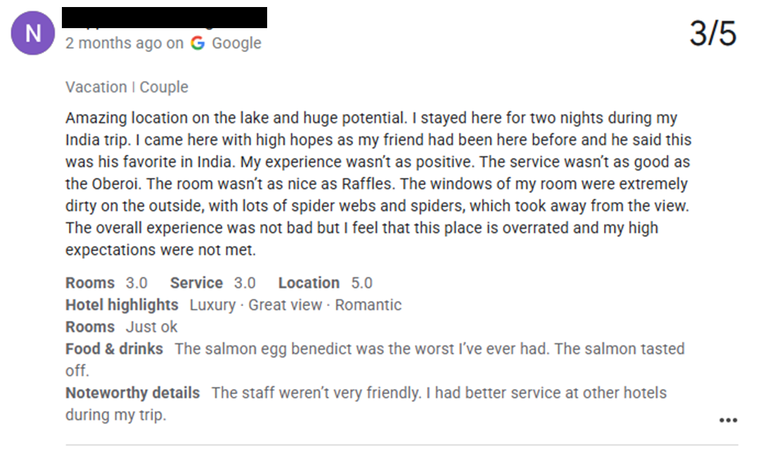
The Customer Gap
Can you think of other examples of the customer gap?

Slide 7
To close the customer gap, 4 provider gaps need to be closed
    The listening gap
    The service design and standards gap
    The service performance gap
    The communication gap

Slide 8
The Listening Gap
The difference between customer expectations of service and a company’s understanding of those expectations.
Reasons this occurs:
  Inadequate understanding of customers
  Managers / firms do not interact directly with customers
  Unwilling to ask about expectations
  Unprepared to address expectations

Slide 9
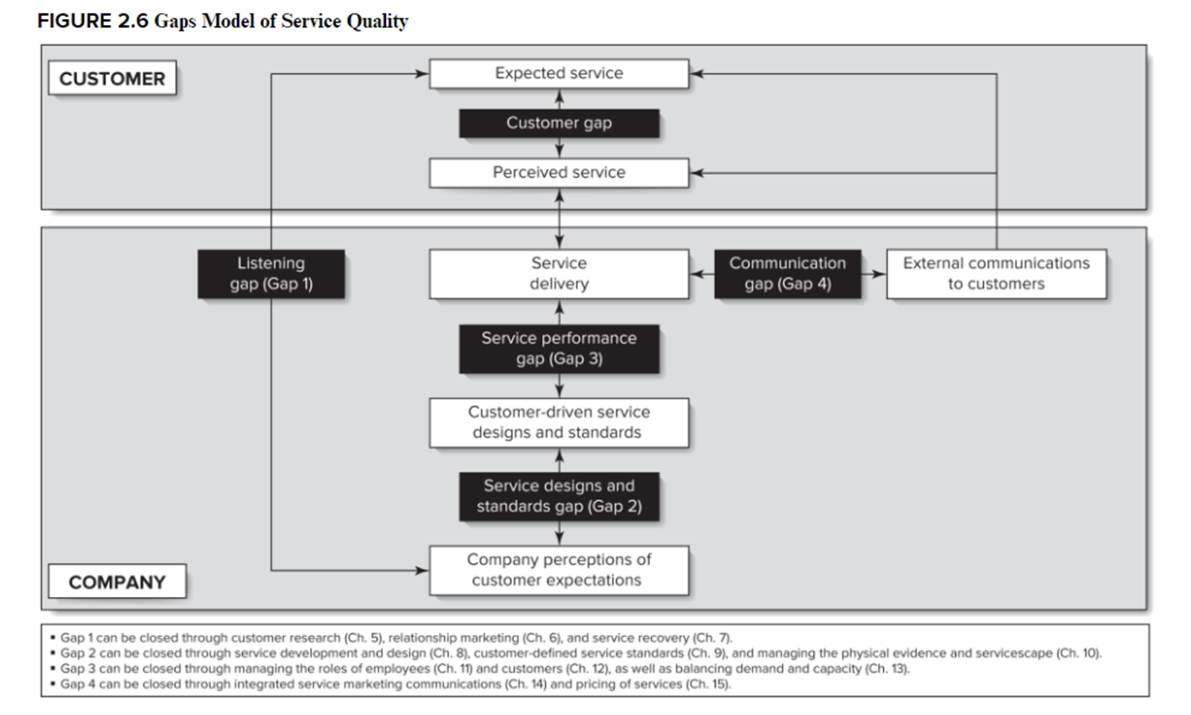
The Service Design and Standards Gap
The difference between company understanding of customer expectations and development of design and standards to match these expectations.
Reasons this occurs:
  Belief that customer expectations are unreasonable or unrealistic
  Belief that the degree of variability inherent in service defies standardization and thus setting standards will not achieve the goals
  An unwillingness to tackle the challenges associated with creating service standards to deliver excellent service.
Notes:
Quality of service delivered by frontline employees to customers is influenced by the standards against which they are evaluated and compensated. Thus, ensuring the customer expectations match the employee standards is necessary.

Slide 10
The Service Performance Gap
This gap is the disparity between customer-driven standards and real service performance.
Service excellence requires more than design and standards; actual service performance is essential.
Critical inhibitors include:
  Employees & customers do not understand their roles
  Inadequate technology, support
  Internal practices requiring cross-functional attention
Notes:
Firm should have systems, processes, and people in place to ensure that service delivery actually matches (or is even better than) the designs and standards in place.

Slide 11
The Communication Gap
This gap illustrates the difference between the actual service delivery and the service provider’s external communications.
External communications impact customer perceptions by giving cues that allow customers to assess quality or educate customers on the product.
Reasons for this gap:
    Overpromising
    Lack of integrated marketing communications
    Inappropriate pricing
    Insufficient internal communication

Slide 12
So how do we close these gaps?
Putting it all together…

Slide 13
Closing the Gaps
All following chapters in this course are aimed at developing strategies to close these gaps.
Remember we started with this….
Notes:
The key to closing customer gap is to close the four provider gaps

Slide 15
In-Class Assignment
Read the WSJ article on Starbucks’ policy reversal and discuss the following questions:
  Which gap do you think they are most attempting to close through this action?
  How does it impact employee?
  How does it impact customers’ behavior?
  Which segment of customers do you think is most going to be impacted by this policy?
  What (if anything) can do they better?

Slide 16
Summary
We discussed the customer gap.
We discussed the gaps model with the four provider gaps that can lead to customer gap.
    The listening gap
    The service design and standards gap
    The service performance gap
    The communication gap

